Slide 1







Restaurant Management System
Prepared By:
Dhyan Moradiya(202103103510451) B.Tech. CSE (3rd Semester)
AMTICS.
Guided By:
Ms. Ankita Desai
Assistant Professor AMTICS.
1

Slide 2
Outline
Introduction
Motivation
Objective
Scope
Analysis for development
Modules
Diagrams
Technologies/Platform to be used for development
Implementation
RMS, AMTICS
2

Slide 3
Introduction
Now a days restaurant customer rush is too mush that increase chance to errors in bills that leads customer unsatisfaction.
This Restaurant management system solves the problem.
This Restaurant management system manage all orders and bills accurate and error lessly.
Restaurant management system helps and manage most of administration and management work of the restaurant.
RMS, AMTICS
3

Slide 4
Motivation
Restaurant management system will develop to help the restaurant administration to manage restaurant management
Nowadays , many restaurant manage their business by manually especially take customer ordering . Today , restaurant waiter takes the customer ordering by manual system with paper . This is problem for waiter the probability lost and duplicates customer information , it would affect to reputation restaurant in operate managing of order, therefore this management system is useful to customer and administration both.
RMS, AMTICS
4

Slide 5
Objective
The main purpose of this project is to create such a restaurant management system which will save time of both customer and restaurant management team. On the hand it will help to run business with much more efficiently than past
With this system waiter can order food easily and order’s copy will go online directly to kitchen room and cash counter immediately.
The only objective of this project is to make restaurant management easier, error less and automated.
RMS, AMTICS
5

Slide 6
Scope
Customer order them self can order their food directly by their device.
Customer can reserve the table from site
Restaurant admin can analysis the restaurant growth with chart like best selling item, best selling category etc
RMS, AMTICS
6

Slide 7
Analysis for development
Workflow of the project
1) Home-page
- Home
About us
Menu
Contact us
2) Sign-Up / Sign-In page
RMS, AMTICS
7

Slide 8
Analysis for development
Dashboard
- Home
Take orders
Orders
Order-List
Menu
Bi l
Staff
Setting
RMS, AMTICS
8

Slide 9
Modules
Admin
Admin Login
- Authentication of Admin.
Dashboard Home
- Minimal sells figure panel.
- Table live status.
Staff Info
- Information of staff their name , contact and email.
- Facility to add/remove staff.
Bill
- See bill and update its status.
Update Menu
- Add/Remove items of menu with price and photo
Order list
- See and Update order status
RMS, AMTICS
9

Slide 10
Modules
Waiter
Waiter Login
- Authentication of Waiter.
Dashboard Home
- Table live status.
Take order
- Can take customers orders
Order list
- See and Update order status
RMS, AMTICS
10

Slide 11
Modules
Cook
Waiter Cook
- Authentication of Cook.
Dashboard Home
- Table live status.
Order list
- See and Update order status
RMS, AMTICS
11

Slide 12
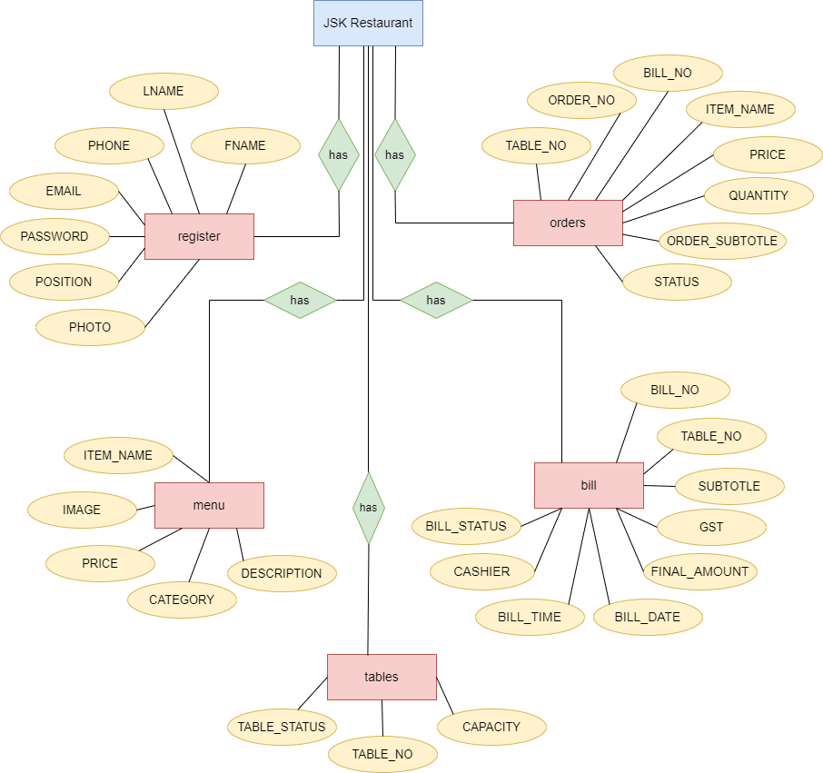
Diagrams
E-R diagram
RMS, AMTICS
12

Slide 13
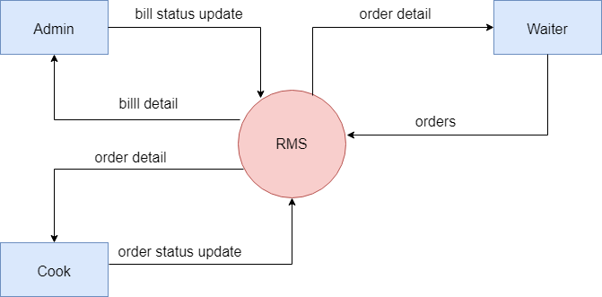
Diagrams
Data flow diagram
Level - 0
RMS, AMTICS
13

Slide 14
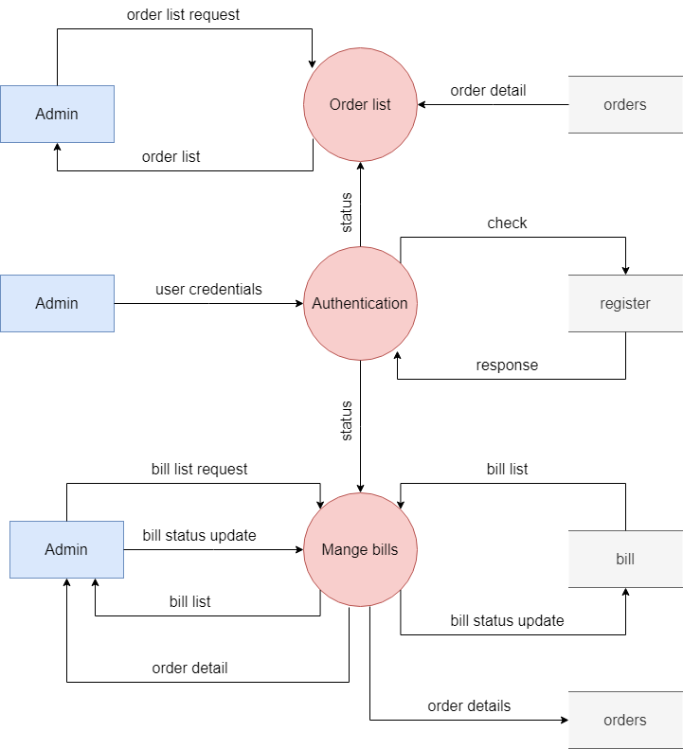
Diagrams
Data flow diagram
Level – 1 (Admin)
RMS, AMTICS
14

Slide 15
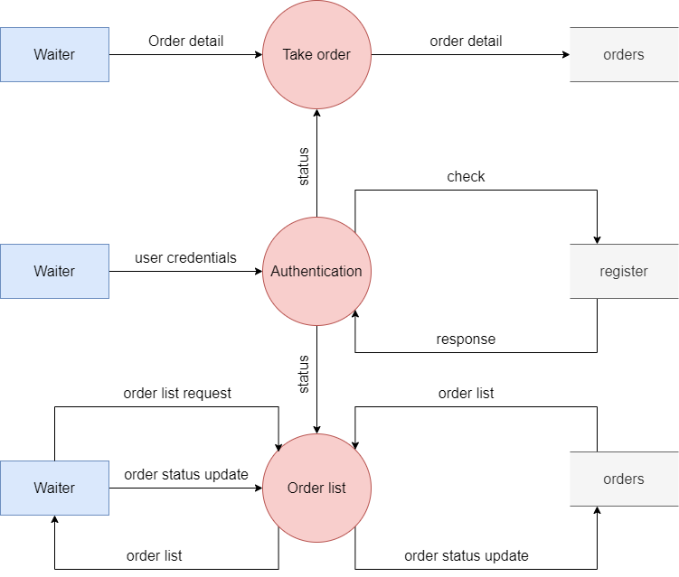
Diagrams
Data flow diagram
Level – 1 (Waiter)
RMS, AMTICS
15

Slide 16
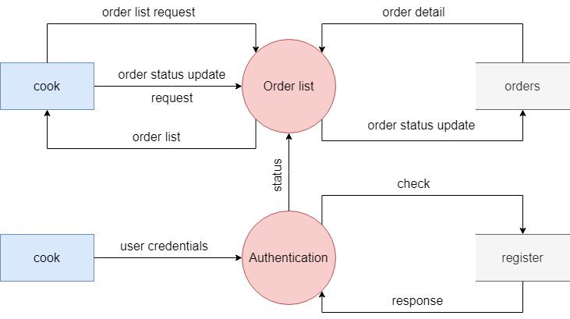
Diagrams
Data flow diagram
Level – 1 (Cook)
RMS, AMTICS
16

Slide 17
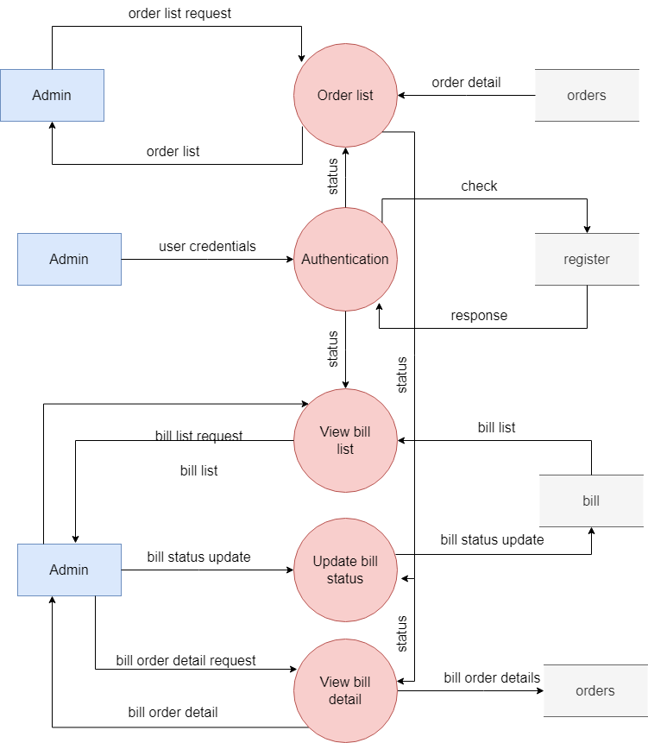
Diagrams
Data flow diagram
Level – 2 (Admin)
RMS, AMTICS
17

Slide 18
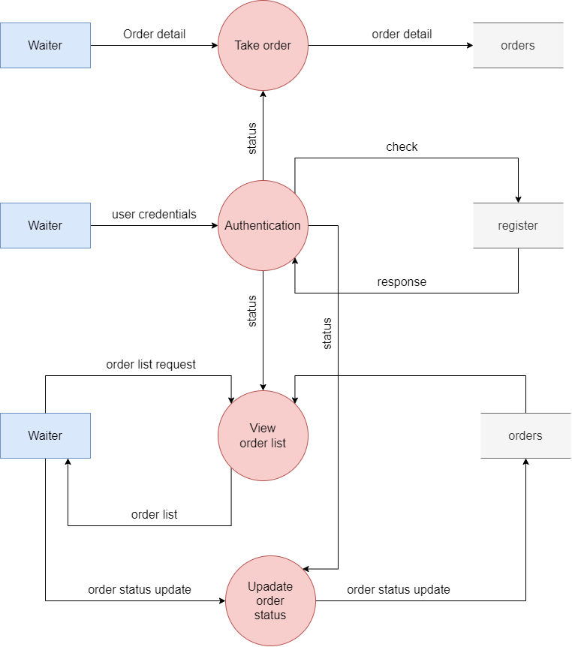
Diagrams
Data flow diagram
Level – 2 (Waiter)
RMS, AMTICS
18

Slide 19
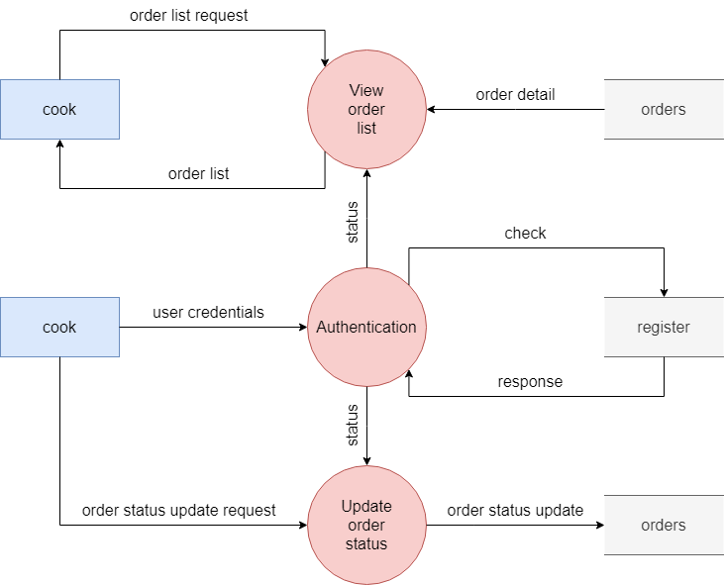
Diagrams
Data flow diagram
Level – 2 (Cook)
RMS, AMTICS
19

Slide 20
Technologies/Platform to be used for development
Front end
Technologies
HTML
CSS
Javascript
Platform
Visual Studio Code
Mozilla Firefox
Google Chrome
RMS, AMTICS

Slide 21
Technologies/Platform to be used for development
back end
Technologies
PHP
mysql
Platform
Visual Studio Code
Mozilla Firefox
Google Chrome
Xampp sever
RMS, AMTICS

Slide 22
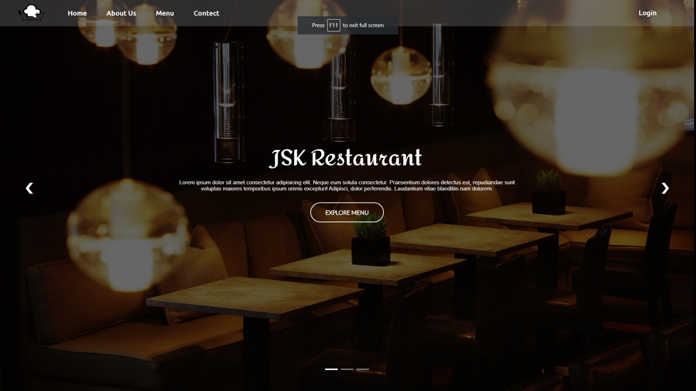
Implementation
Screenshots
Home page
RMS, AMTICS

Slide 23
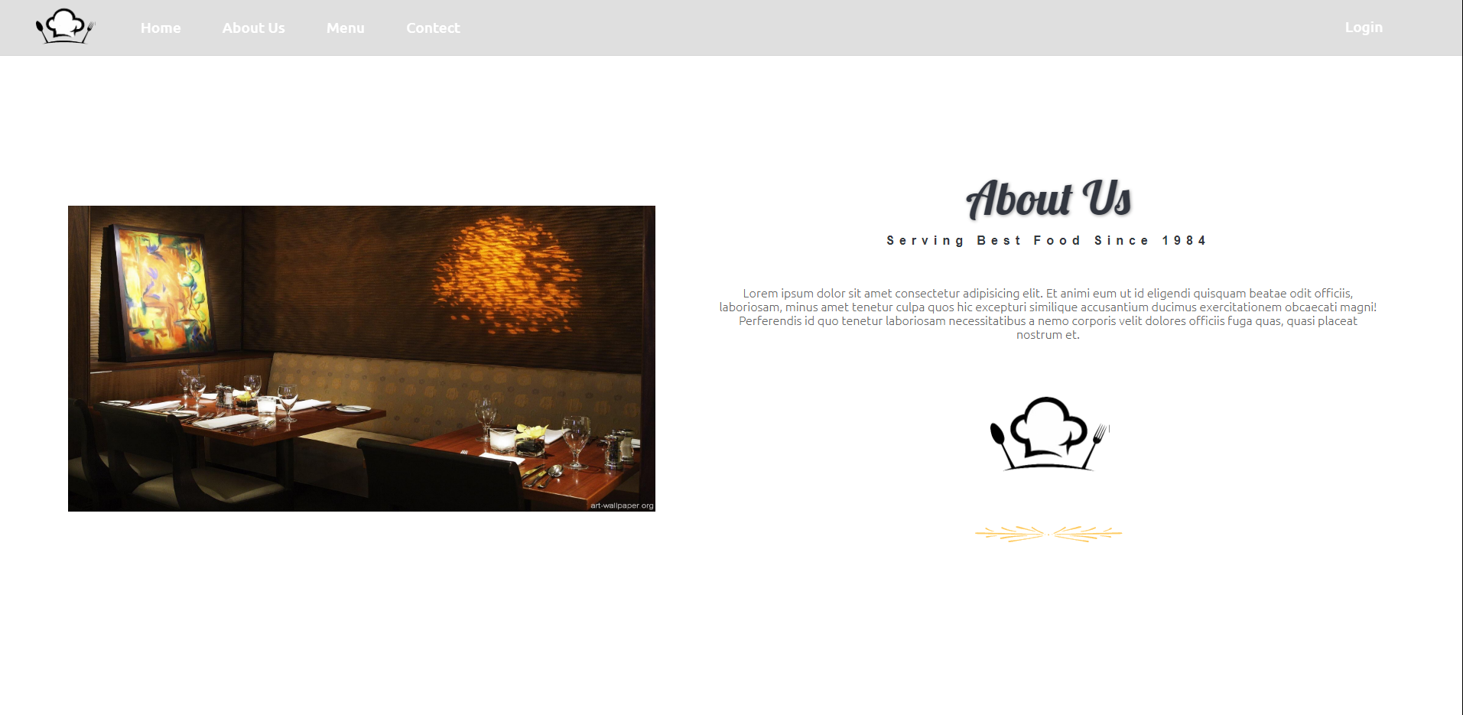
About Us

Slide 24
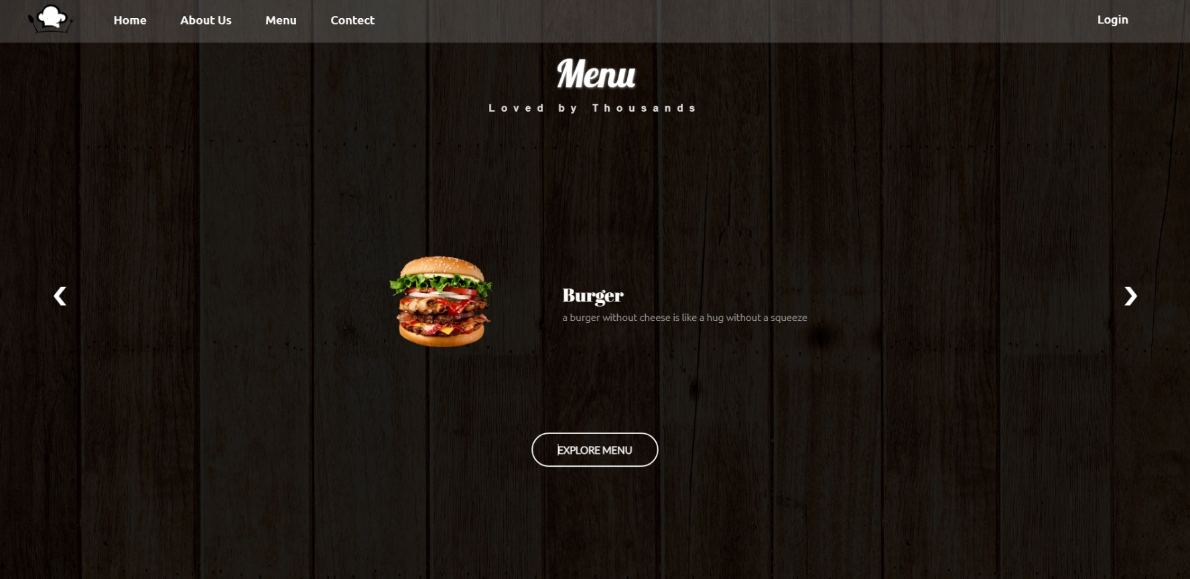
Menu

Slide 25
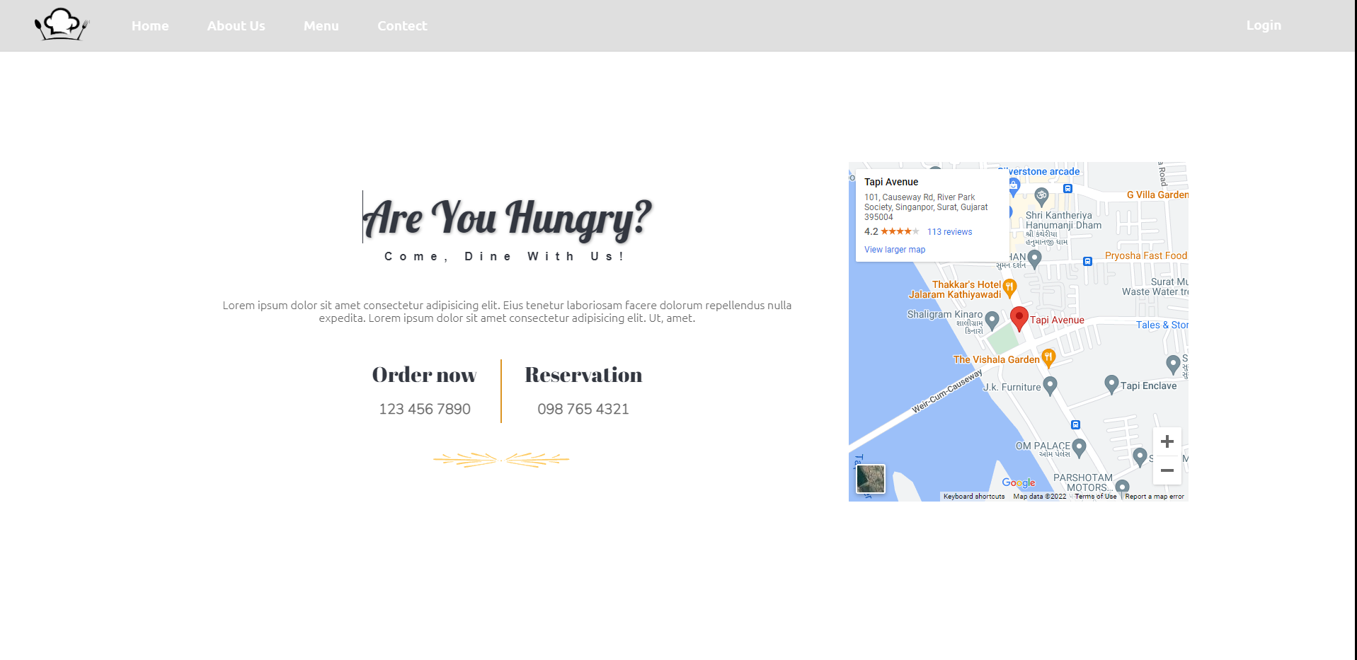
Contact Us

Slide 26
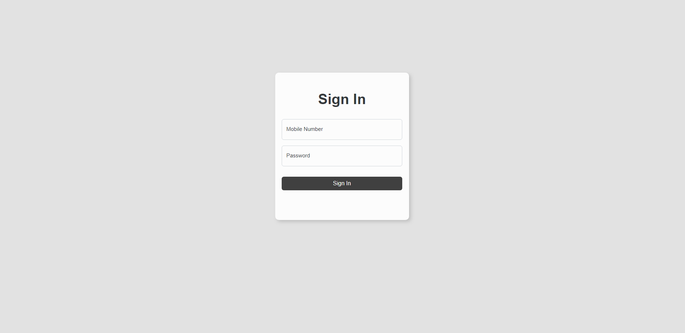
Log in

Slide 27
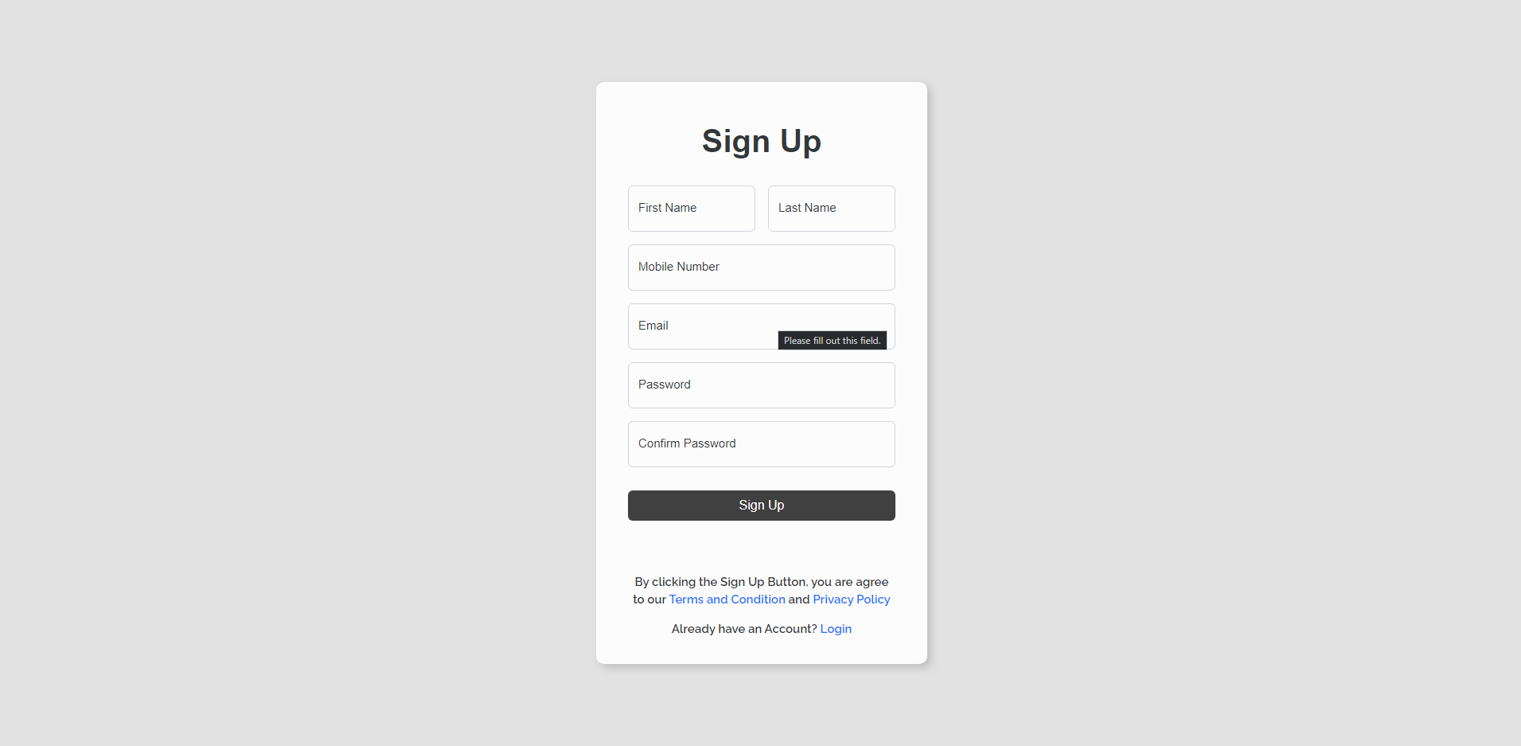
Sign up

Slide 28
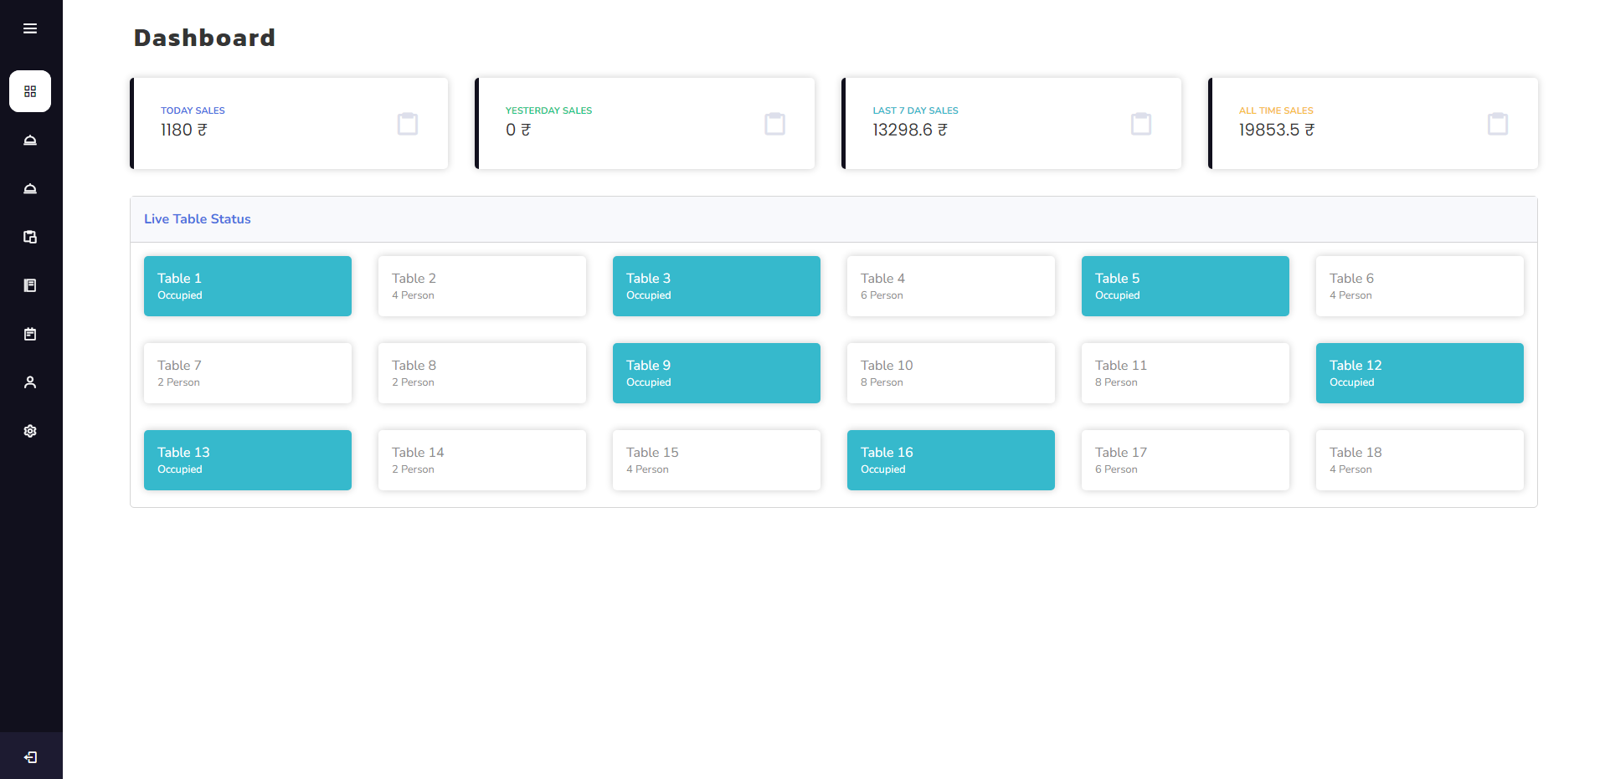
Dashboard - home

Slide 29
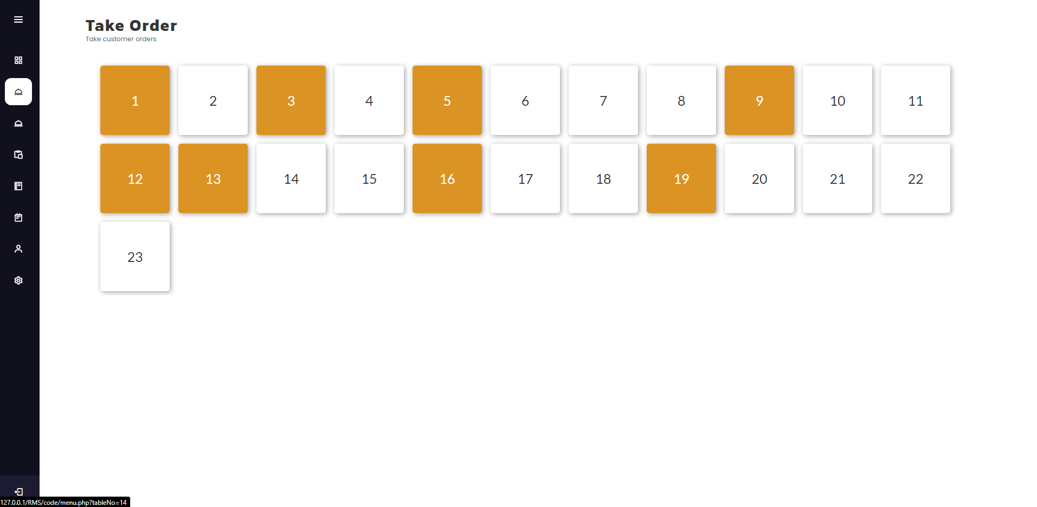
Dashboard - take order

Slide 30
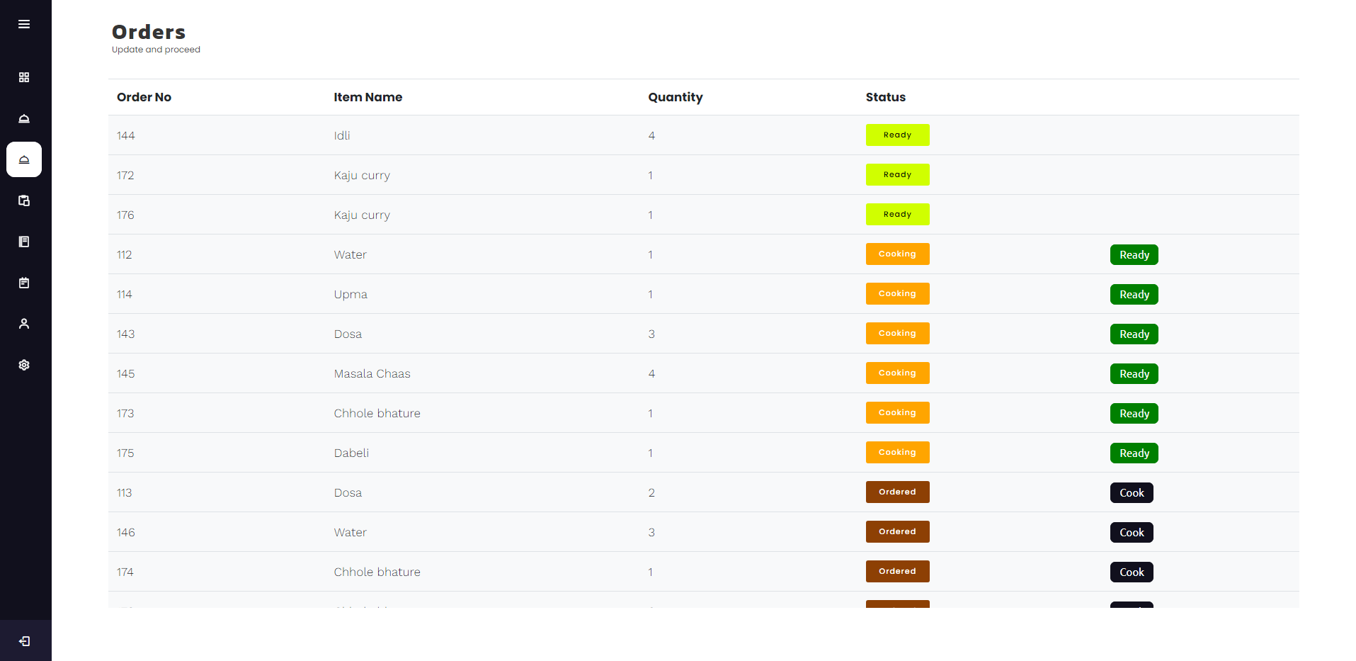
Dashboard - orders

Slide 31
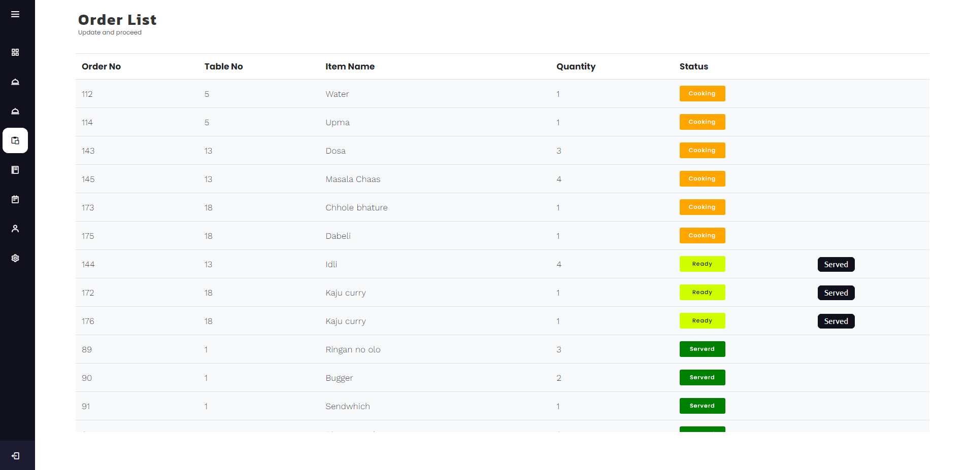
Dashboard – order list

Slide 32
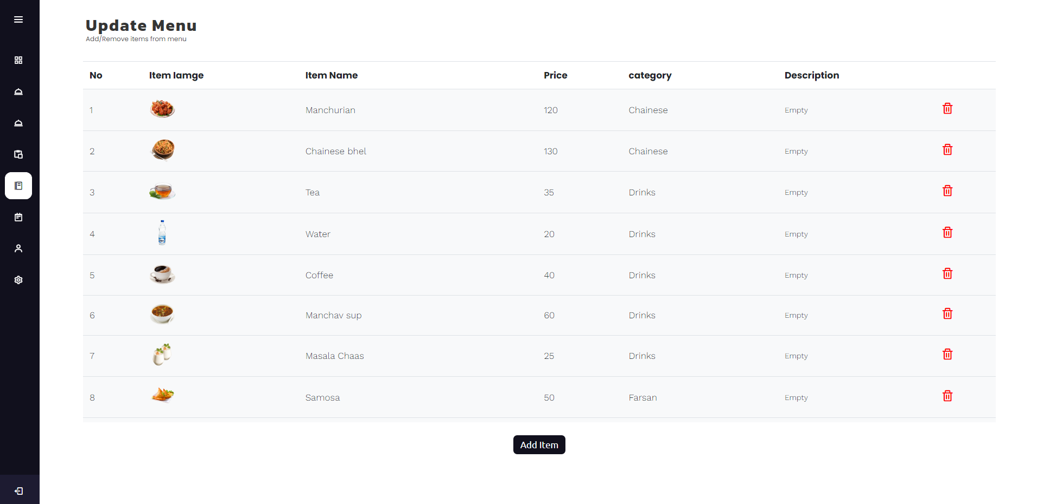
Dashboard – update menu

Slide 33
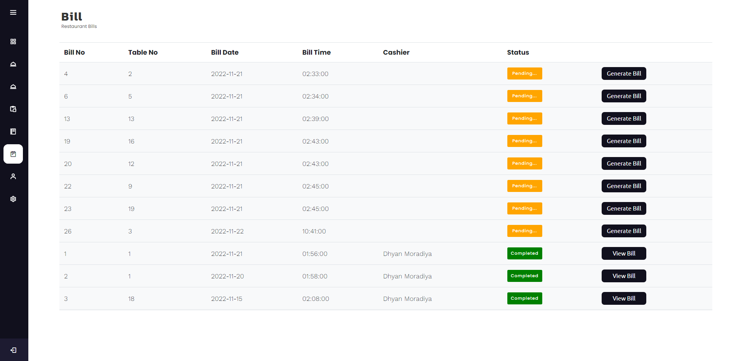
Dashboard – Bill

Slide 34
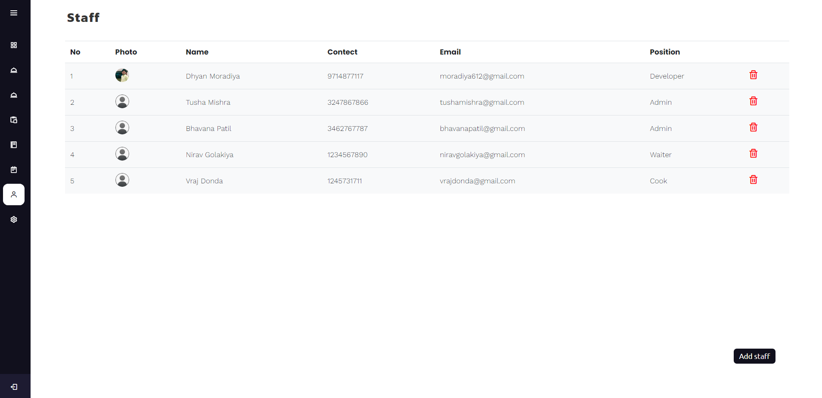
Dashboard – Staff

Slide 35
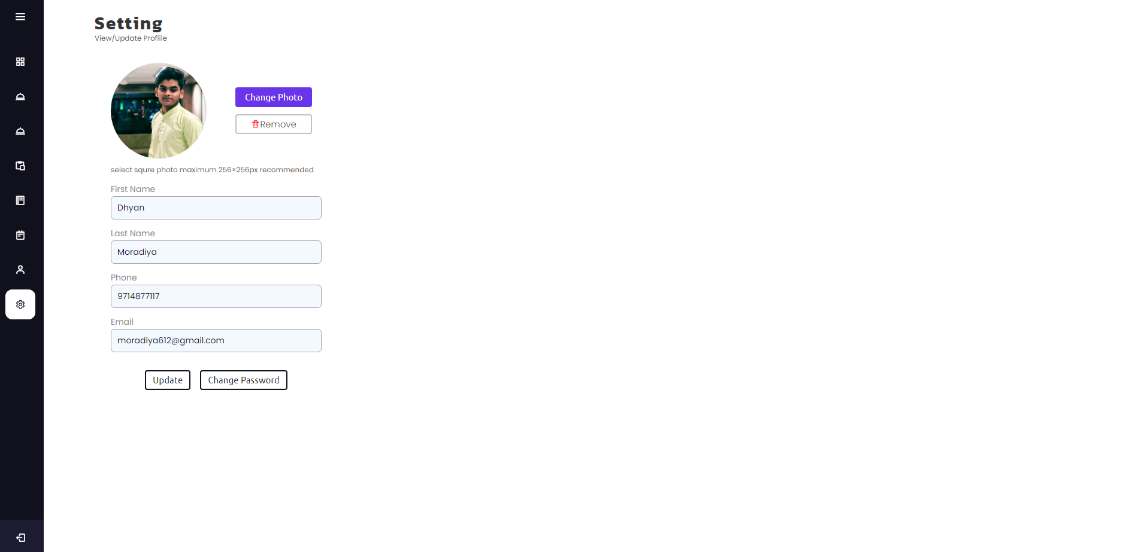
Dashboard – Setting

Slide 36
Thank You!
RMS, AMTICS

